Slide 1
Minimum wage in the European Union and Italy
European Parliament
Brussels, 26 September 2023
A useful but insufficient shield
against internal and external unfair competion
Stefano Fassina

Slide 2
Objectives
In November 2017, the European Parliament, the Council and the Commission proclaimed the European Pillar of Social Rights to deliver on Europe’s promise of “prosperity, progress and convergence, and make social Europe a reality for all”;
When set at adequate levels, minimum wages ensure a decent living for workers, help sustain domestic demand, strengthen incentives to work, and reduce in-work poverty and wage inequality.
Since more women than men earn the minimum wage, minimum wages also help reduce the gender pay gap;
No crowding out wages set by collective bargaining.

Slide 3
Definitions (Directive EU 2022/2041)
‘minimum wage’ means the minimum remuneration set by law or collective agreements that an employer, including in the public sector, is required to pay to workers for the work performed during a given period;
‘statutory minimum wage’ means a minimum wage set by law, with the exclusion of minimum wages set by collective agreements that have been declared universally applicable without any discretion of the declaring authority as to the content of the applicable provisions;
Member States shall use indicative reference values commonly used at international level such as 60 % of the gross median wage and 50 % of the gross average wage, and/or indicative reference values used at national level.

Slide 4
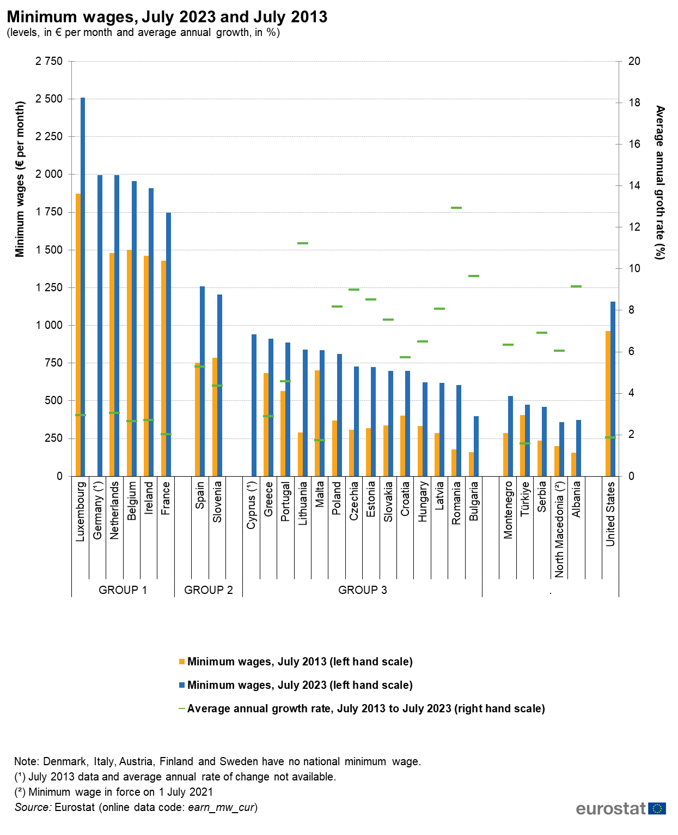

Slide 5
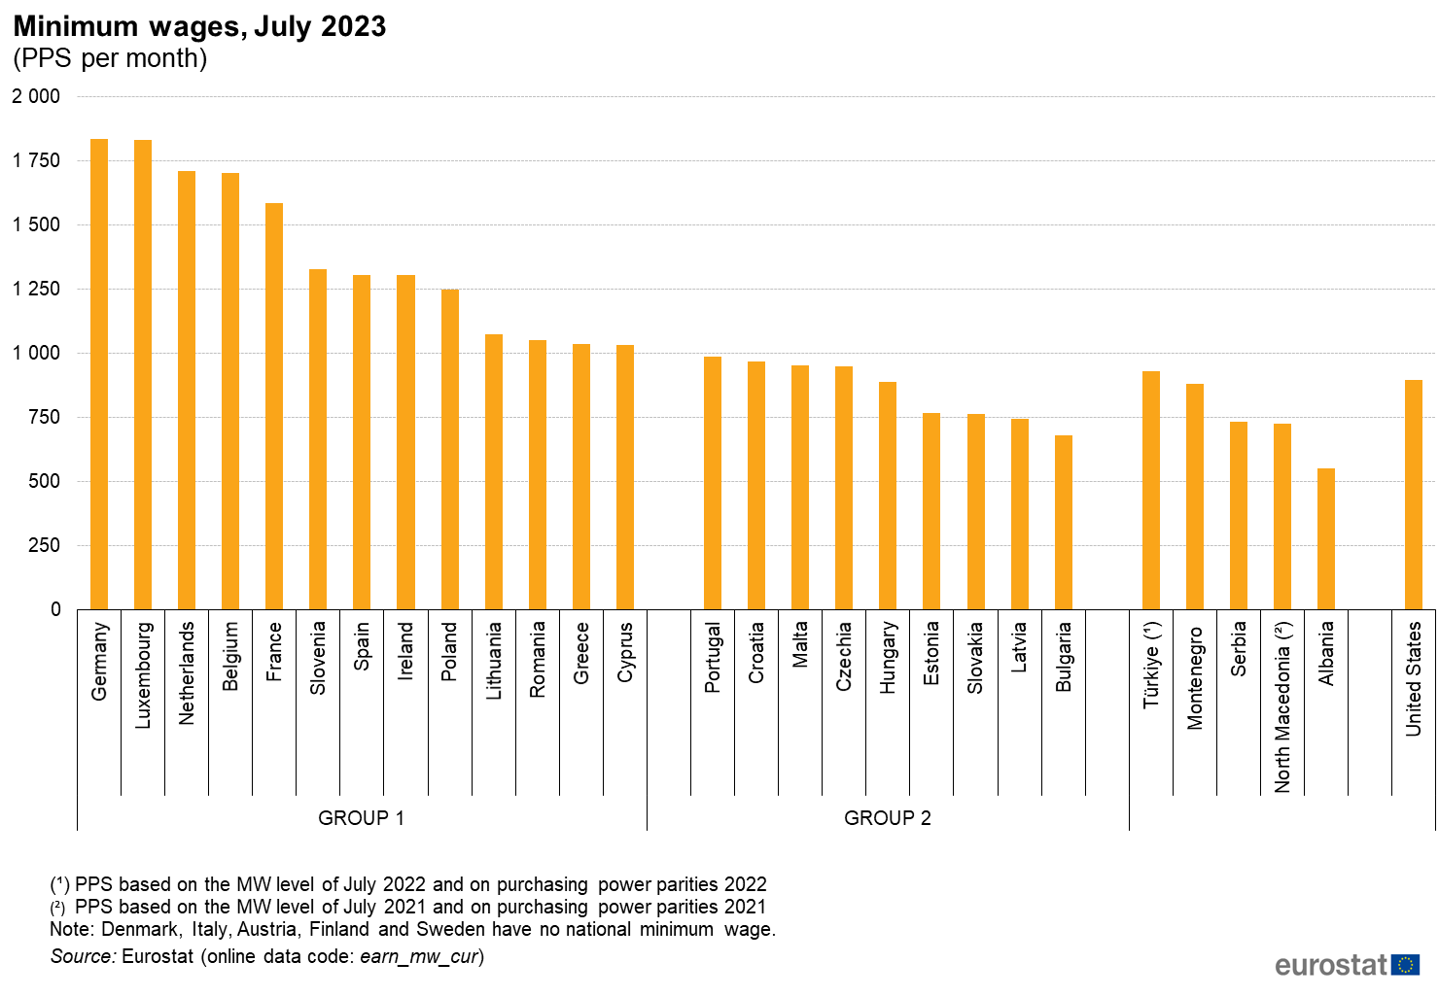

Slide 6
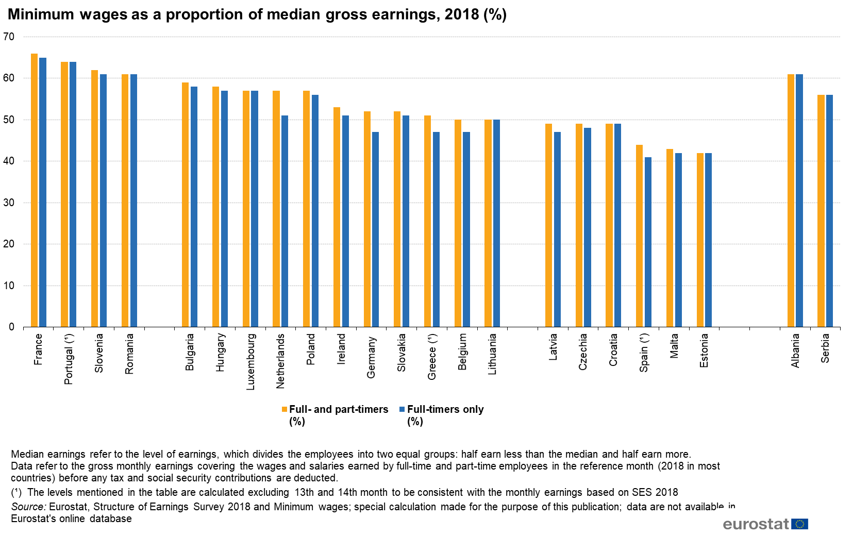

Slide 7
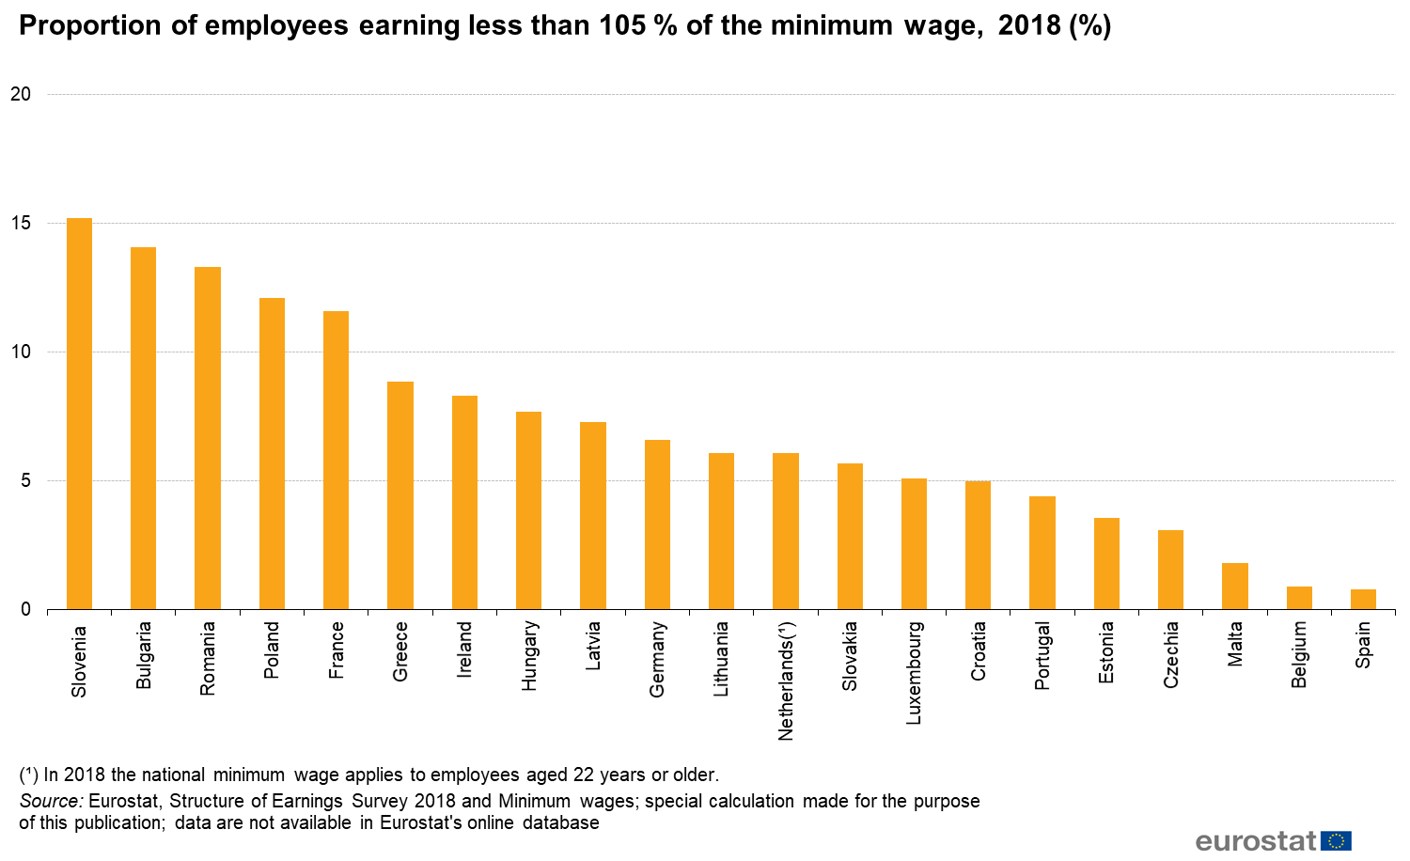

Slide 8
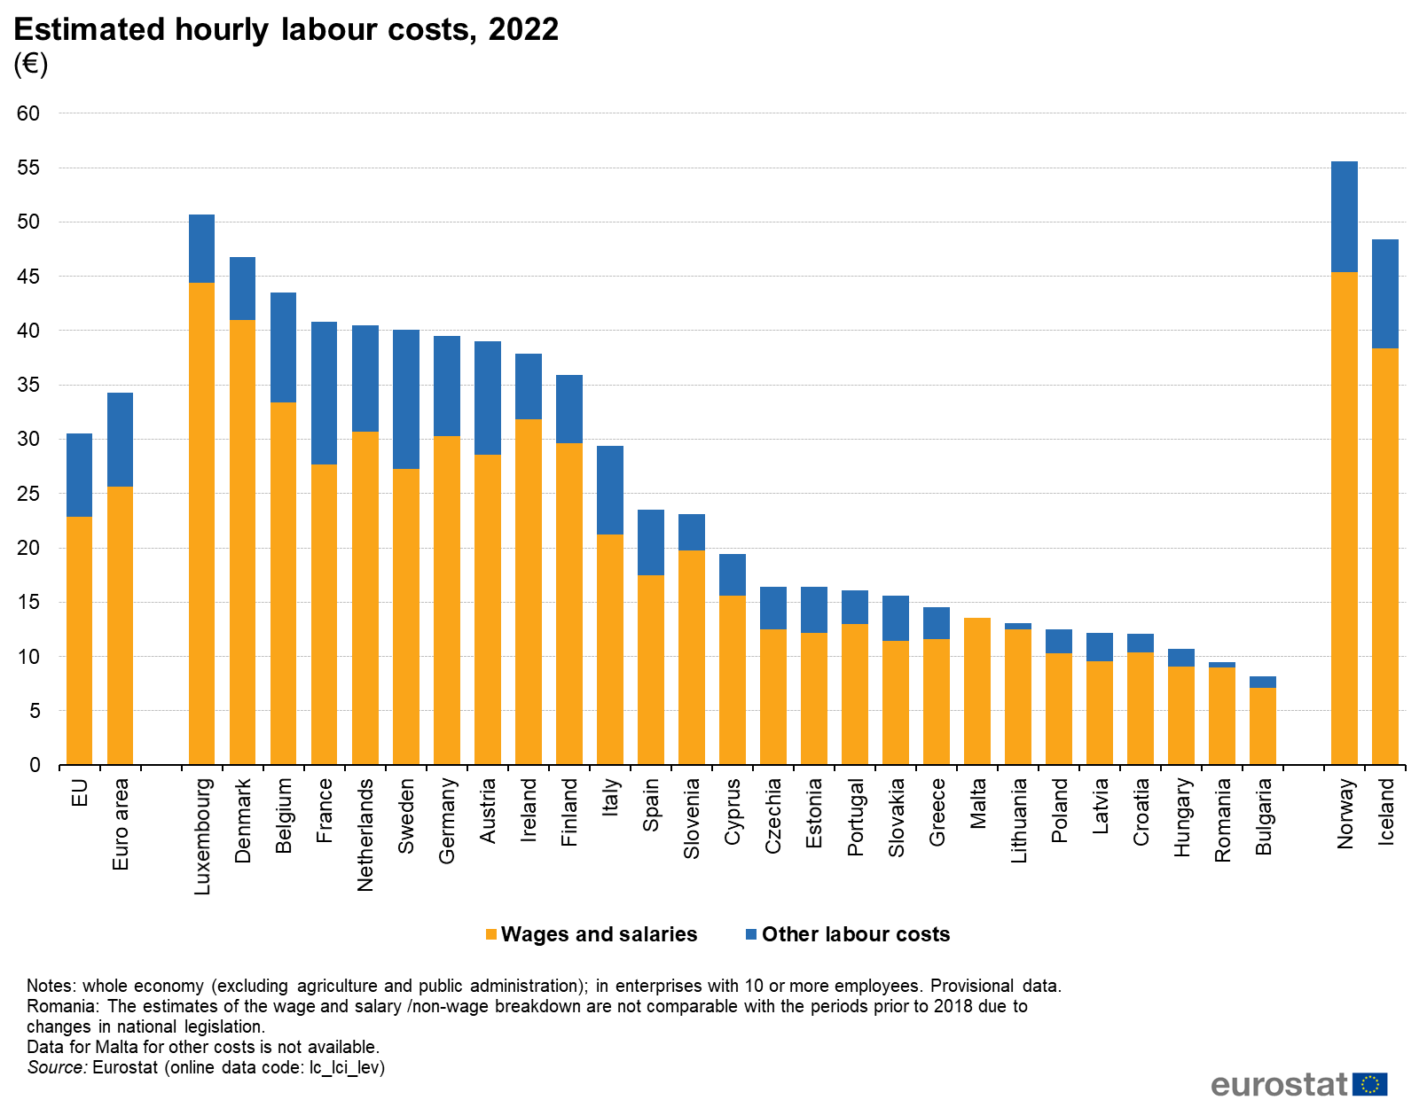

Slide 9
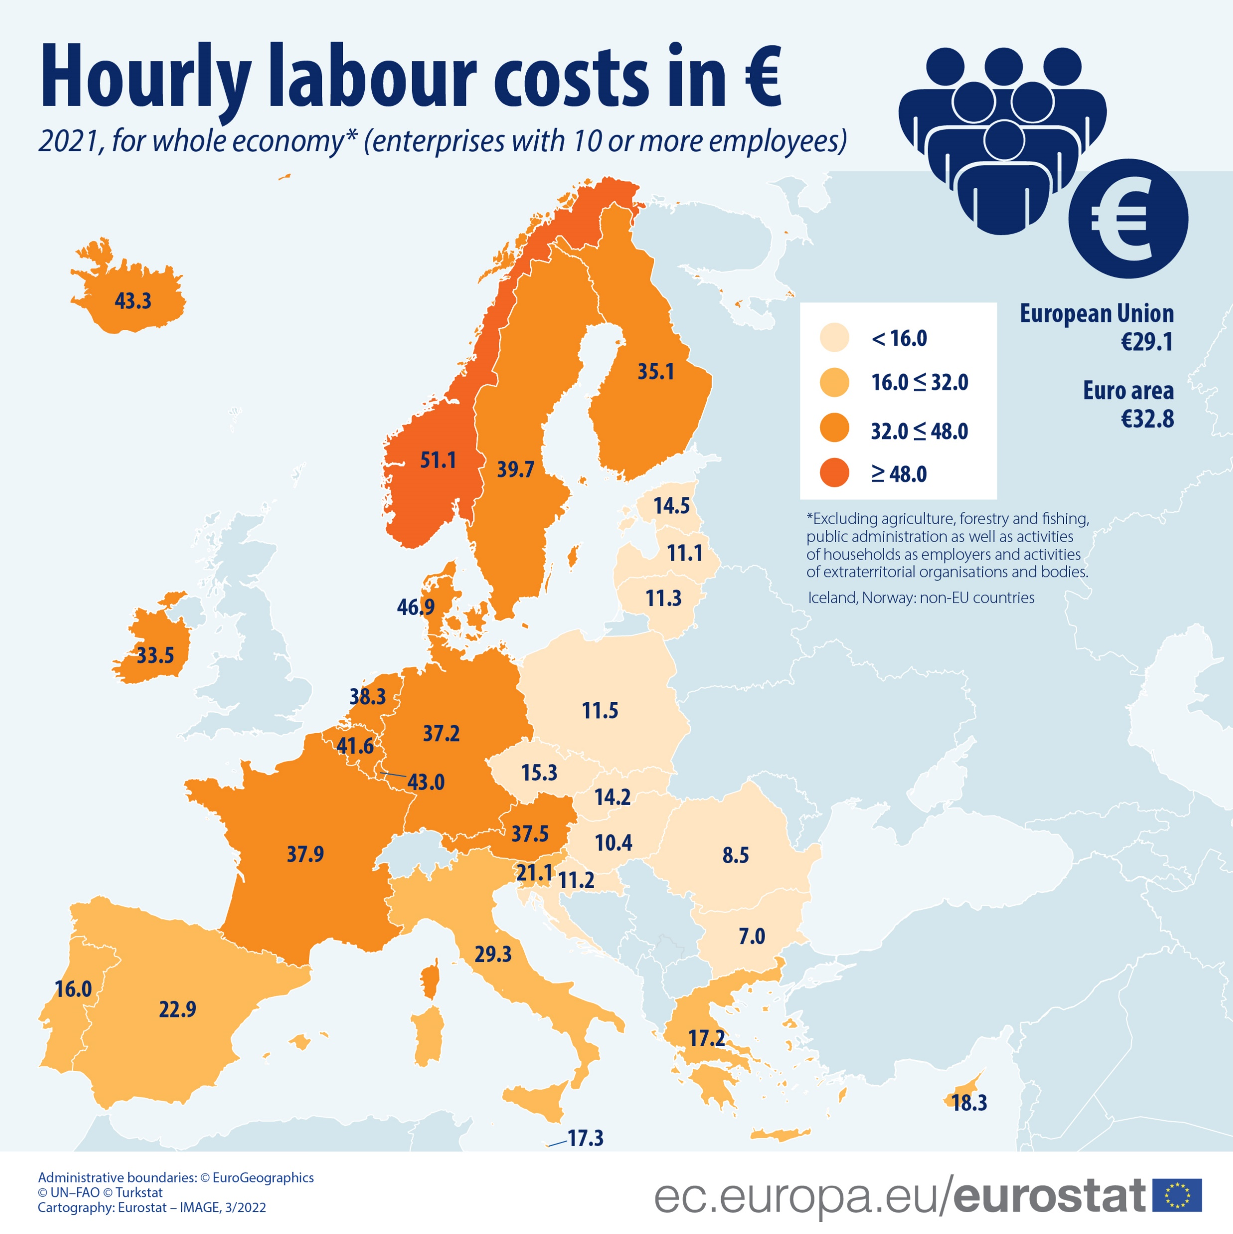

Slide 10
Comments
22 member States and all the low wage member States already had the minimum wage when the EU Direcitve was agreed (no minimum wage: Austria, Denmark, Finland, Italy and Sweden);
The pre-existing (gross) minimum wage is about 50% of median (gross) earnings in each member State: on a monthly basis (euros), from 2500 in Lux to 400 in Bulgaria;
The existing minimum wage solutions are coherent with the EU Directive : i.e., «adequate»;
These data underline the dramatic and unchallenged differences of labour cost in the european single market.

Slide 11
Italy
For Italy, the Directive supports the political parties and trade unions (basically all, except Cisl) campaigning for introducing the minimum wage;
The (gross) minimum wage proposed is 9 euro per hour, about 75% of the (gross) median wage;
An independent commission established by the Ministry of Labour in 2021 estimate 22% of employees receiving less than 9 euro per hour (about 4 million employees);
Among the working poors, employees covered by collective bargaining signed by the major trade unions (Cgil, Cisl, Uil).

Slide 12
Comments 1/5
An adequate minimum wage is useful against domestic wage devaluation. It should be introduced by law as mandatory, asap in Italy;
In a tailored solution, a minimum compensation should be considered for self-employed, real and fake (misguised employees). i.e., all market-taker workers;
It’s a minimum:
  about 50-60% of median wages eroded by 20 years of social dumping (coming from within and outside the european single market) and 18 months of inflation;
  missing benefits, seniority, training;
It should not weaken policies for strengthening unionization and collective bargaining;

Slide 13
Comments 2/5
Wages and labour conditions are by fare more affected by macroeconomic and regulatory policies than labour policies, including wage policies;
Several factors contribute to explain wage moderation in the last 3 decades: industrial re-organization; de-industrialization and financialization, labour-saving tech, skill mismatch, etc;
The most relevant and less considered factor is regulation of capital, goods, services and people flows, the 4 economic liberties. The global regulations and the european single market regulations provide the setting for unfair competition and, at the end of the day, wage devaluation and more difficult labour conditions;
The Directive on minimum wage does not affect external pressure on wage devaluation;

Slide 14
Comments 3/5
“Some US policymakers now look back to the decision to admit China to the WTO as a mistake. They believe that the huge boost this gave to Chinese exports also contributed significantly to the deindustrialisation of America. Rising inequality in the US then helped to fuel the rise of Donald Trump”. Gideon Rachman, FT, 18/09/23;
UAW strike in US to avoid domestic unfair competition: multinationals want to use the American South —where many new EV jobs are heading since labour and environmental standards tend to be lower— as, in effect, their own personal China;
“Models can misled on the impact of global trade” (Rana Foroohar, FT, 25/09/23). An assessment of models applied to measure the impact of the Eu single market on wages would be very useful;

Slide 15
Comments 4/5
The welfare (wage, taxation, workers rights, unionization, etc) differences among EU member States are more relevant than those in US (see: M. Matthijs – C. parson, “Single-Market Power. How Europe Surpassed America in the Quest for Economic Integration”, Foreign Affairs May-June 2022), and almost as relevant as the ones between US and China and EU and China or other emerging economies;
For increasing wages and improving labour conditions, restraining unfair competition is key: e.g., Carbon Border Adjustment Mechanism; Tariffs on EV;

Slide 16
Comments 5/5
For restraining unfair competition in the EU, changes are needed to important Directives: e.g., Bolkestein, Posted workers. Namely, the principle of «country of origin» should be completely replaced by the principle of «country of destination» and the principle of free movement of services restricted to no labour intensive activities;
Beware of EU enlargement: “For geopolitical reasons, EU enlargement is high on the political agenda, but the EU is not ready yet to welcome new members, neither institutionally nor policy wise” (Report, Group of 12). As in consequence of the 2004 enlargement, workers would paid (average gross hourly wage prevailing in candidate States is about 3€).

